Slide 1
C# Fundamentals

Slide 2
What is C#?
It is an object-oriented programming language provided by Microsoft that runs on .Net Framework.

Slide 3
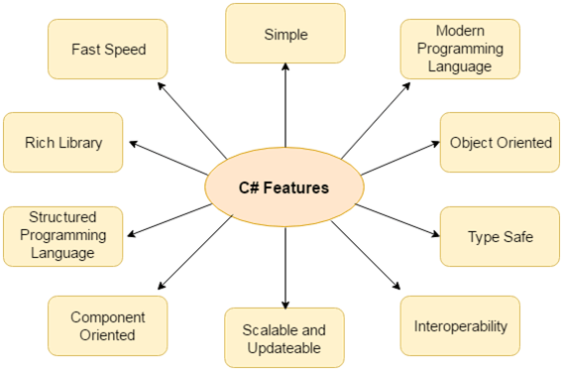

Slide 4
Java Vs C#
Java | C#
Java is a high level, robust, secured and object-oriented programming language developed by Oracle. | C# is an object-oriented programming language developed by Microsoft that runs on .Net Framework.
Java programming language is designed to be run on a Java platform, by the help of Java Runtime Environment (JRE). | C# programming language is designed to be run on the Common Language Runtime (CLR).
In java, built-in data types that are passed by value are called primitive types. | In C#, built-in data types that are passed by value are called simple types.
Arrays in Java are direct specialization of Object. | Arrays in C# are specialization of System.
Java doesn't support goto statement. | C# supports goto statement.
Java doesn't support structures and unions. | C# supports structures and unions.
Java supports checked exception and unchecked exception. | C# supports unchecked exception.

Slide 5
C# Variables
A variable is a name of memory location. It is used to store data. Its value can be changed and it can be reused many times.
Variable Type | Example
Decimal types | decimal
Boolean types | True or false value, as assigned
Integral types | int, char, byte, short, long
Floating point types | float and double
Nullable types | Nullable data types

Slide 6
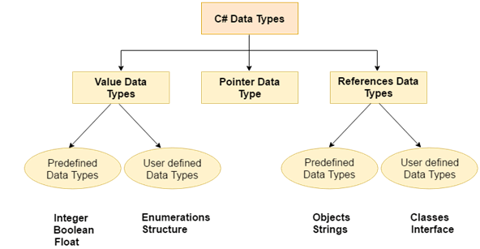
C# datatypes

Slide 7
C# Operators
Arithmetic Operators
Relational Operators
Logical Operators
Bitwise Operators
Assignment Operators
Unary Operators
Ternary Operators

Slide 8
C# Keywords
byte char checked class continue decimal private
public return explicit extern false finally fixed float for
foreach implicit in unchecked using unsafe virtual void null object operator out
default delegate do double else enum event
sealed short sizeof static string struct
switch this throw true try abstract base as bool break catch case volatile while

Slide 9
C# Control Statements
In C# programming, the if statement is used to test the condition. There are various types of if statements in C#.
if statement
if-else statement
nested if statement

Slide 10
C# Switch
The C# switch statement executes one statement from multiple conditions.

Slide 11
C# For Loop
The C# for loop is used to iterate a part of the program several times. If the number of iteration is fixed, it is recommended to use for loop than while or do-while loops.

Slide 12
C# While Loop
In C#, while loop is used to iterate a part of the program several times. If the number of iteration is not fixed, it is recommended to use while loop than for loop.

Slide 13
C# Do-While Loop
The C# do-while loop is used to iterate a part of the program several times. If the number of iteration is not fixed and you must have to execute the loop at least once, it is recommended to use do-while loop.
The C# do-while loop is executed at least once because condition is checked after loop body.

Slide 14
C# Goto Statement
The C# goto statement is also known jump statement. It is used to transfer control to the other part of the program. It unconditionally jumps to the specified label.
It can be used to transfer control from deeply nested loop or switch case label.
Currently, it is avoided to use goto statement in C# because it makes the program complex.

Slide 15
C# Function
Function is a block of code that has a signature. Function is used to execute statements specified in the code block. A function consists of the following components:
Function name: It is a unique name that is used to make Function call.
Return type: It is used to specify the data type of function return value.
Body: It is a block that contains executable statements.

Slide 16
C# Call By Value
In C#, value-type parameters are that pass a copy of original value to the function rather than reference. It does not modify the original value. A change made in passed value does not alter the actual value.

Slide 17
C# Call By Reference
C# provides a ref keyword to pass argument as reference-type. It passes reference of arguments to the function rather than copy of original value. The changes in passed values are permanent and modify the original variable value.

Slide 18
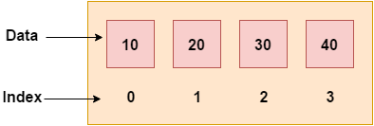
C# Arrays
Like other programming languages, array in C# is a group of similar types of elements that have contiguous memory location. In C#, array is an object of base type System.Array. In C#, array index starts from 0. We can store only fixed set of elements in C# array.

Slide 19
Advantages and Disadvantages of Arrays
Advantages of C# Array
Code Optimization (less code)
Random Access
Easy to traverse data
Easy to manipulate data
Easy to sort data etc.
Disadvantages of C# Array
Fixed size

Slide 20
Types of Arrays
Single Dimensional Array
Multidimensional Array
Jagged Array

Slide 21
Multidimensional Array
The multidimensional array is also known as rectangular arrays in C#. It can be two dimensional or three dimensional. The data is stored in tabular form (row * column) which is also known as matrix.
To create multidimensional array, we need to use comma inside the square brackets.

Slide 22
Jagged Arrays
In C#, jagged array is also known as "array of arrays" because its elements are arrays. The element size of jagged array can be different.

Slide 23
C# Array class
C# provides an Array class to deal with array related operations. It provides methods for creating, manipulating, searching, and sorting elements of an array. This class works as the base class for all arrays in the .NET programming environment.

Slide 24
C# Constructor
In C#, constructor is a special method which is invoked automatically at the time of object creation. It is used to initialize the data members of new object generally. The constructor in C# has the same name as class or struct.
There can be two types of constructors in C#.
Default constructor
Parameterized constructor

Slide 25
C# Destructor
A destructor works opposite to constructor, It destructs the objects of classes. It can be defined only once in a class. Like constructors, it is invoked automatically.
C# destructor cannot have parameters.

Slide 26
C# this
In C# programming, “this” is a keyword that refers to the current instance of the class. There can be 3 main usage of this keyword in C#.
It can be used to refer current class instance variable. It is used if field names (instance variables) and parameter names are same, that is why both can be distinguish easily.
It can be used to pass current object as a parameter to another method.
It can be used to declare indexers.

Slide 27
C# static
In C#, static is a keyword or modifier that belongs to the type not instance. So instance is not required to access the static members. In C#, static can be field, method, constructor, class, properties, operator and event.
Advantage of C# static keyword:
Memory efficient: Now we don't need to create instance for accessing the static members, so it saves memory.

Slide 28
C# Structs
In C#, classes and structs are blueprints that are used to create instance of a class. Structs are used for lightweight objects such as Color, Rectangle, Point etc.

Slide 29
C# Enum
Enum in C# is also known as enumeration. It is used to store a set of named constants such as season, days, month, size etc. The enum constants are also known as enumerators. Enum in C# can be declared within or outside class and structs.
Enum constants has default values which starts from 0 and incremented to one by one. But we can change the default value.

Slide 30
C# Namespaces
Namespaces in C# are used to organize too many classes so that it can be easy to handle the application.
In a simple C# program, we use System.Console where System is the namespace and Console is the class. To access the class of a namespace, we need to use namespacename.classname. We can use using keyword so that we don't have to use complete name all the time.

Slide 31
C# Strings
In C#, string is an object of System.String class that represent sequence of characters. We can perform many operations on strings such as concatenation, comparison, getting substring, search, trim, replacement etc.

Slide 32
C# Exception Handling
Exception Handling in C# is a process to handle runtime errors. We perform exception handling so that normal flow of the application can be maintained even after runtime errors.
In C#, exception is an event or object which is thrown at runtime. All exceptions are derived from System.Exception class. It is a runtime error which can be handled. If we don't handle the exception, it prints exception message and terminates the program.

Slide 33
Checked and Unchecked Exceptions
C# provides checked and unchecked keyword to handle integral type exceptions. Checked and unchecked keywords specify checked context and unchecked context respectively. In checked context, arithmetic overflow raises an exception whereas, in an unchecked context, arithmetic overflow is ignored and result is truncated.

Slide 34
C# Generics
Generic is a concept that allows us to define classes and methods with placeholder. C# compiler replaces these placeholders with specified type at compile time. The concept of generics is used to create general purpose classes and methods.
To define generic class, we must use angle <> brackets. The angle brackets are used to declare a class or method as generic type.

Slide 35
C# Collections
In C#, collection represents group of objects. By the help of collections, we can perform various operations on objects such as
store object
update object
delete object
retrieve object
search object, and
sort object
In short, all the data structure work can be performed by C# collections. We can store objects in array or collection. Collection has advantage over array. Array has size limit but objects stored in collection can grow or shrink dynamically.

Slide 36
Types of C# Collections
System.Collections.Generic classes
System.Collections classes (Now deprecated)
System.Collections.Concurrent classes

Slide 37
System.Collections.Generic classes
The System.Collections.Generic namespace has the following classes:
List
Stack
Queue
LinkedList
HashSet
SortedSet
Dictionary
SortedDictionary
SortedList

Slide 38
System.Collections classes
These classes are legacy. It is suggested now to use System.Collections.Generic classes. The System.Collections namespace has following classes:
ArrayList
Stack
Queue
Hashtable

Slide 39
System.Collections.Concurrent classes
The System.Collections.Concurrent namespace provides classes for thread-safe operations. Now multiple threads will not create problem for accessing the collection items.
The System.Collections.Concurrent namespace has following classes:
BlockingCollection
ConcurrentBag
ConcurrentStack
ConcurrentQueue
ConcurrentDictionary
Partitioner
Partitioner
OrderablePartitioner

Slide 40
C# List <T>
C# List<T> class is used to store and fetch elements. It can have duplicate elements.
C# HashSet <T>
C# HashSet class can be used to store, remove or view elements. It does not store duplicate elements. It is suggested to use HashSet class if you have to store only unique elements.

Slide 41
C# SortedSet <T>
C# SortedSet class can be used to store, remove or view elements. It maintains ascending order and does not store duplicate elements. It is suggested to use SortedSet class if you have to store unique elements and maintain ascending order.
C# Stack <T>
C# Stack<T> class is used to push and pop elements. It uses the concept of Stack that arranges elements in LIFO (Last In First Out) order. It can have duplicate elements.

Slide 42
C# Queue <T>
C# Queue<T> class is used to Enqueue and Dequeue elements. It uses the concept of Queue that arranges elements in FIFO (First In First Out) order. It can have duplicate elements.
C# LinkedList <T>
C# LinkedList<T> class uses the concept of linked list. It allows us to insert and delete elements fast. It can have duplicate elements.

Slide 43
C# Dictionary <TKey, TValue>
C# Dictionary<TKey, TValue> class uses the concept of hashtable. It stores values on the basis of key. It contains unique keys only. By the help of key, we can easily search or remove elements.
C# SortedDictionary <TKey, TValue>
C# SortedDictionary<TKey, TValue> class uses the concept of hashtable. It stores values on the basis of key. It contains unique keys and maintains ascending order on the basis of key. By the help of key, we can easily search or remove elements.
C# SortedList <TKey, TValue>
C# SortedList<TKey, TValue> is an array of key/value pairs. It stores values on the basis of key. The SortedList<TKey, TValue> class contains unique keys and maintains ascending order on the basis of key. By the help of key, we can easily search or remove elements.

Slide 44
Difference between SortedList and SortedDictionary
SortedList | SortedDictionary
The memory of SortedList is an overhead. | The memory of SortedDictionary is not bottlenecked.
In SortedList, the elements are stored in a continuous block in memory. | In SortedDictionary, the elements are stored in separate object that can spread all over the heap.
In SortedList, the memory fragmentation is high. | In SortedDictionary, the memory fragmentation is low.
It require less memory for storage. | It require more memory for storage.
In SortedList, less inserts and delete operations are required. | In SortedDictionary, more inserts and delete operations are required.
In SortedList, data are already in sorted form. | In SortedDictionary, data are in un-sorted form.

Slide 45
C# FileStream
C# FileStream class provides a stream for file operation. It can be used to perform synchronous and asynchronous read and write operations. By the help of FileStream class, we can easily read and write data into file.
C# StreamWriter
C# StreamWriter class is used to write characters to a stream in specific encoding. It inherits TextWriter class. It provides overloaded write() and writeln() methods to write data into file.

Slide 46
C# StreamReader
C# StreamReader class is used to read string from the stream. It inherits TextReader class. It provides Read() and ReadLine() methods to read data from the stream.
C# TextWriter
C# TextWriter class is an abstract class. It is used to write text or sequential series of characters into file. It is found in System.IO namespace.

Slide 47
C# TextReader
C# TextReader class is found in System.IO namespace. It represents a reader that can be used to read text or sequential series of characters.
C# BinaryWriter
C# BinaryWriter class is used to write binary information into stream. It also supports writing string in specific encoding.

Slide 48
C# BinaryReader
C# BinaryReader class is used to read binary information from stream. It also supports reading string in specific encoding.
C# StringWriter Class
This class is used to write and deal with string data rather than files. It is derived class of TextWriter class. The string data written by StringWriter class is stored into StringBuilder.
The purpose of this class is to manipulate string and save result into the StringBuilder.

Slide 49
C# StringReader
StringReader class is used to read data written by the StringWriter class. It is subclass of TextReader class. It enables us to read a string synchronously or asynchronously. It provides constructors and methods to perform read operations.

Slide 50
C# FileInfo Class
The FileInfo class is used to deal with file and its operations in C#. It provides properties and methods that are used to create, delete and read file. It uses StreamWriter class to write data to the file. It is a part of System.IO namespace.
C# DirectoryInfo Class
DirectoryInfo class is a part of System.IO namespace. It is used to create, delete and move directory. It provides methods to perform operations related to directory and subdirectory. It is a sealed class so, we cannot inherit it.

